Slide 1
Transfer Learning
Jintong Gao
2024.8.29

Slide 2
Transfer Learning
Transferring Knowledge From Large Foundation Models to Small Downstream Models.
ICML 2024.
3. Tell, Don't Show: Language Guidance Eases Transfer Across Domains in Images and
Videos. ICML 2024.

Slide 3
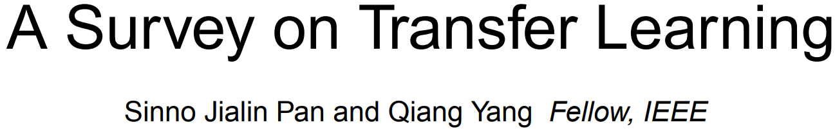
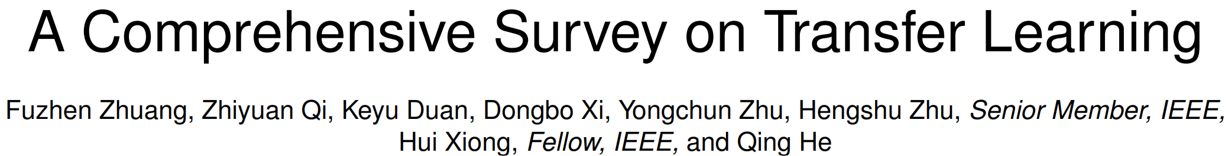
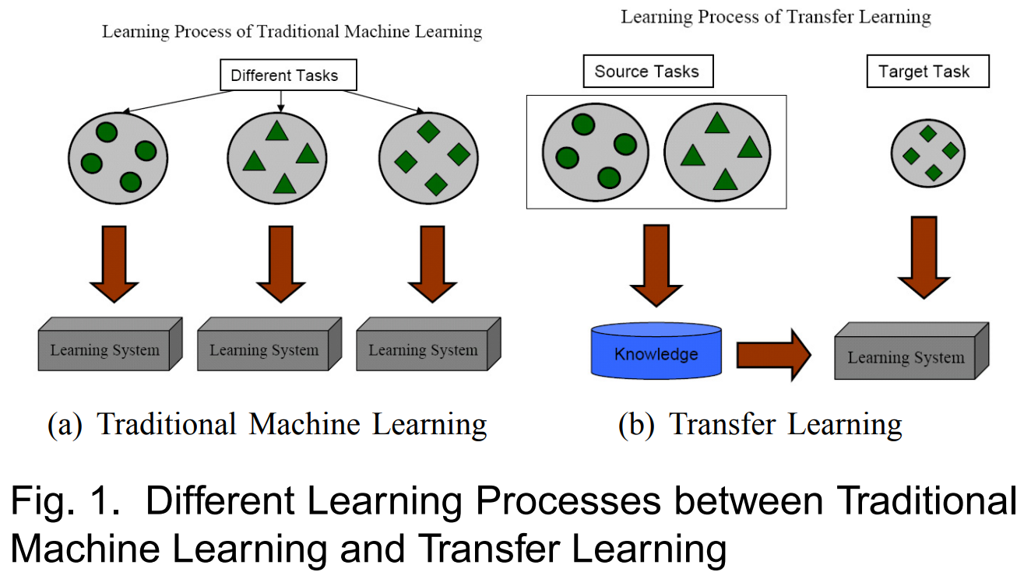
What is transfer learning?

Slide 4
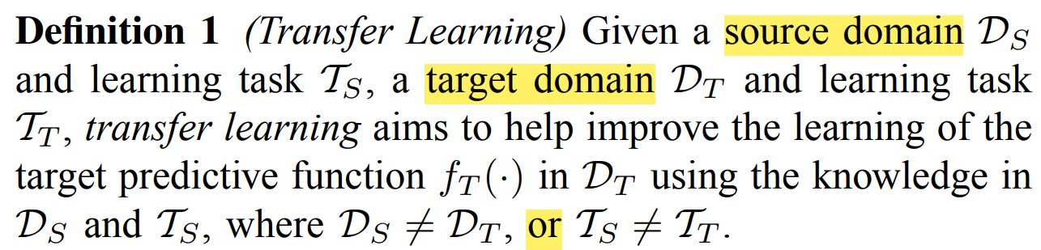

Slide 5
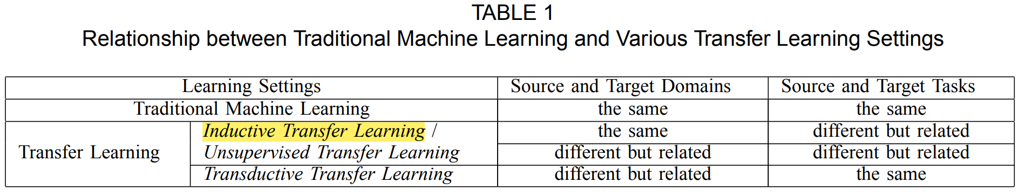
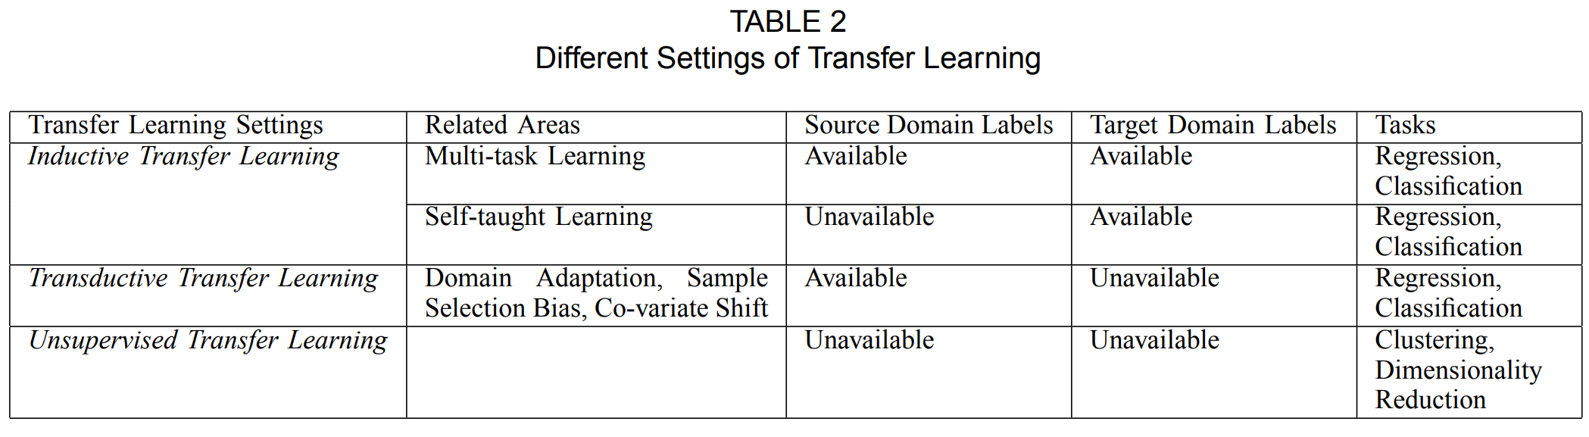

Slide 6
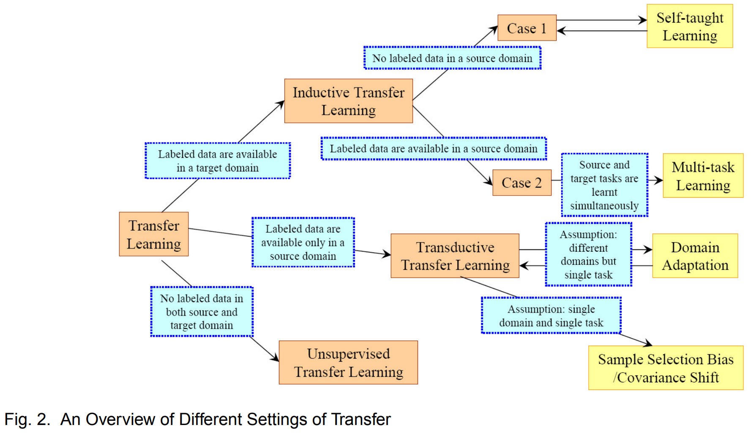

Slide 7
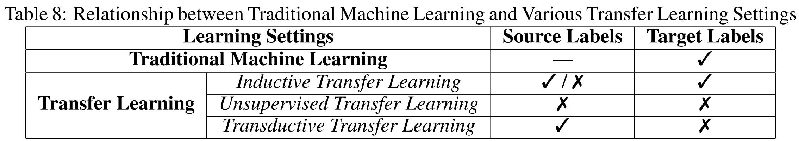
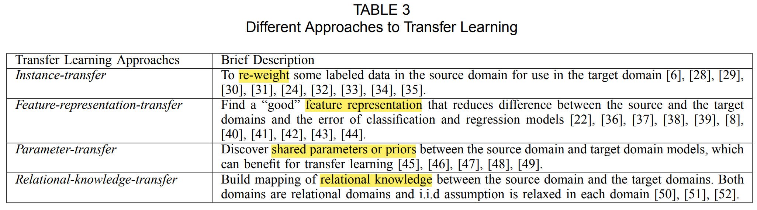

Slide 8
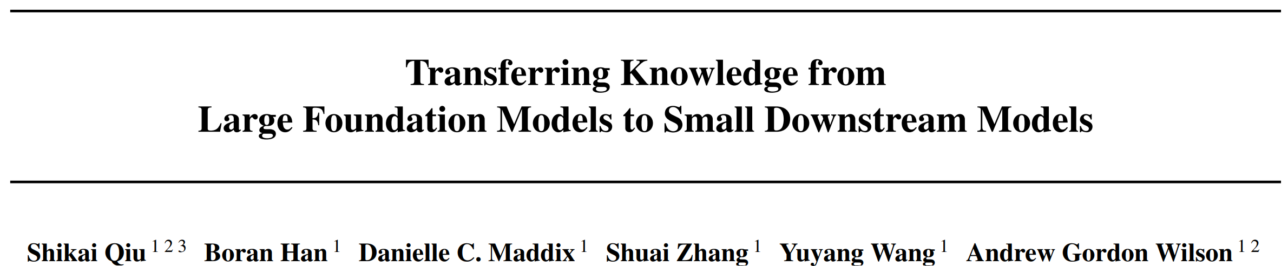
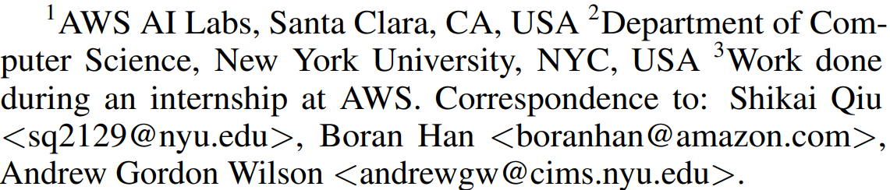
ICML 2024

Slide 9
Motivation: How do we transfer the relevant knowledge from ever larger foundation models into small, task-specific downstream models that can run at much lower costs?
Contributions:
Adaptive Feature Transfer (AFT) transfers knowledge from large foundation models into small downstream models, improving downstream performance with minimal cost.
AFT operates purely on features, thereby decoupling the choice of the pre-trained model from the smaller downstream model, using a simple regularization that adds minimal overhead.
Across multiple vision, language, and multi-modal datasets, AFT achieves significantly better downstream performance compared to alternatives with a similar computational cost, even if the downstream model is over 50× smaller.

Slide 10
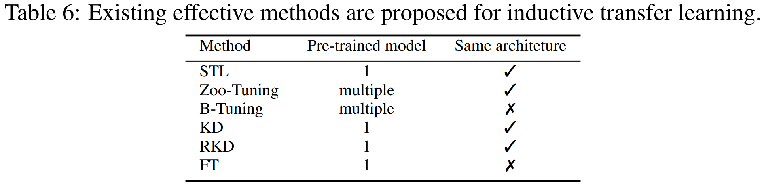
Related Work

Slide 11
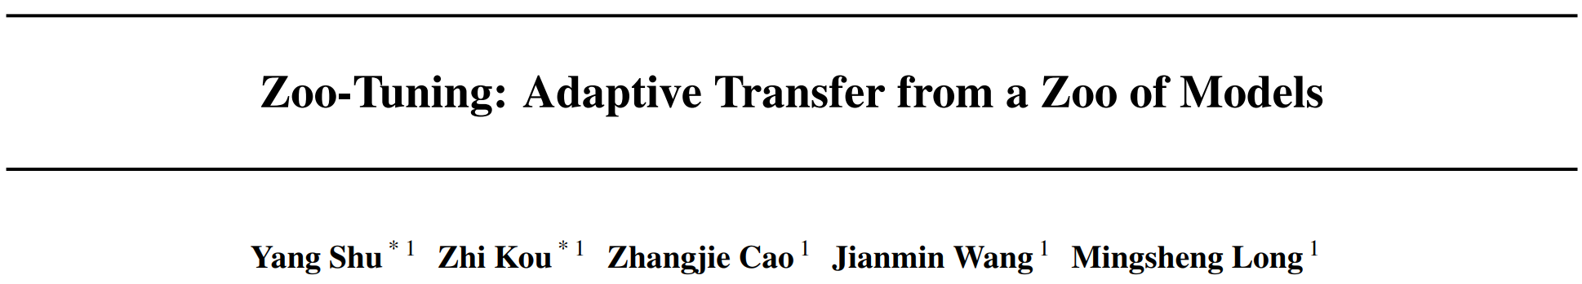
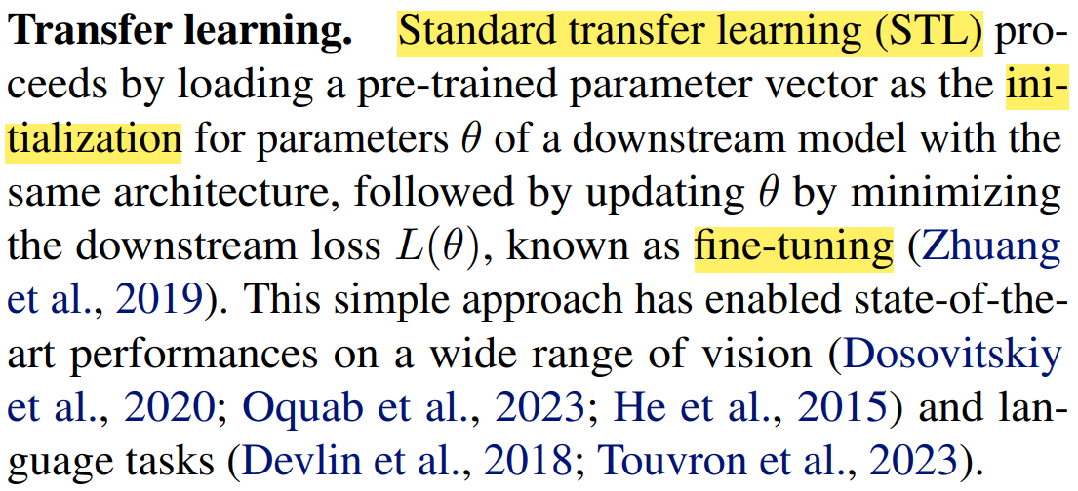
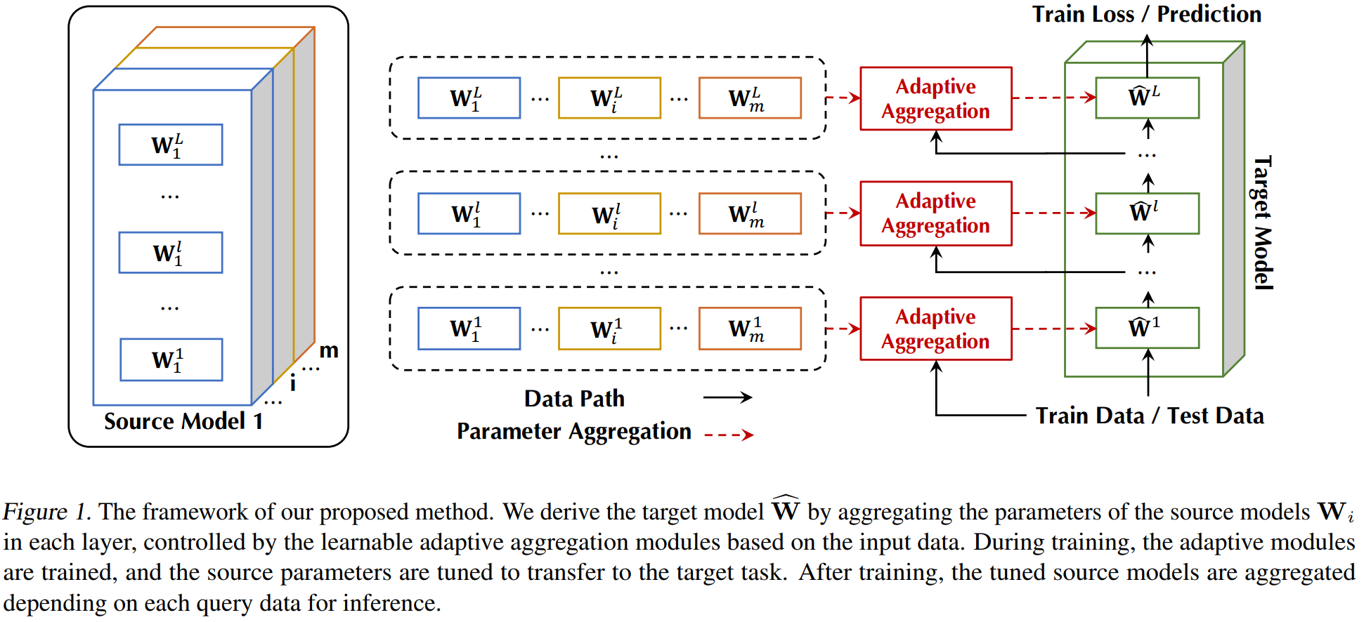

ICML 2021

Slide 12
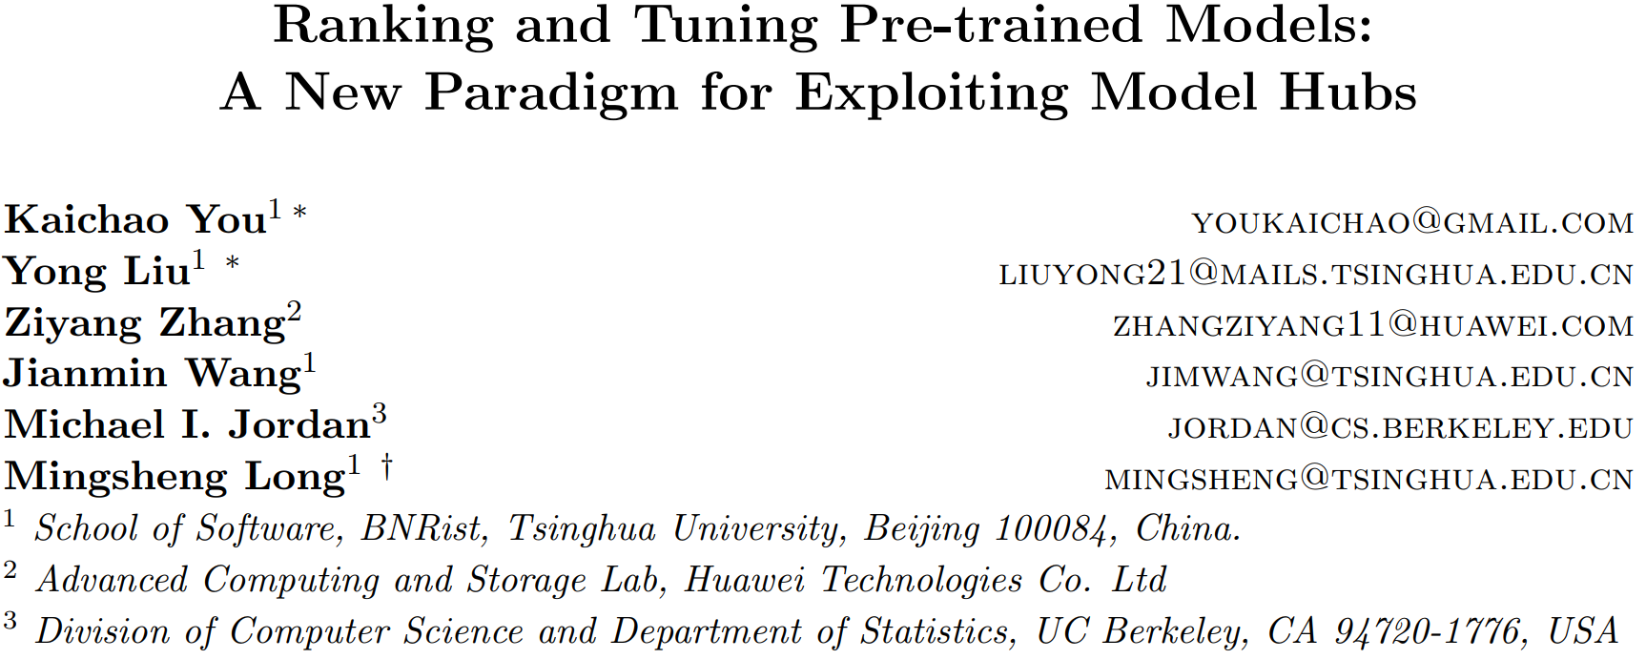
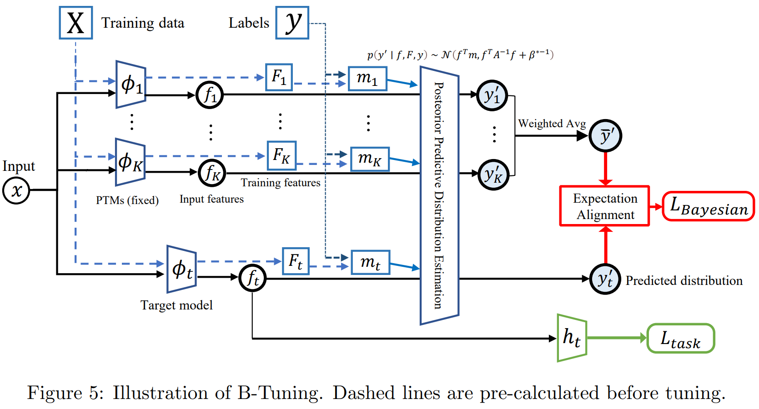
B-Tuning
JMLR 2022

Slide 13
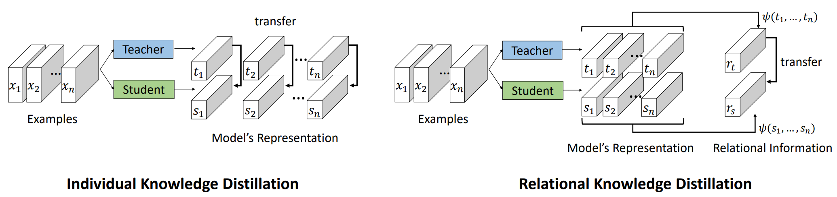
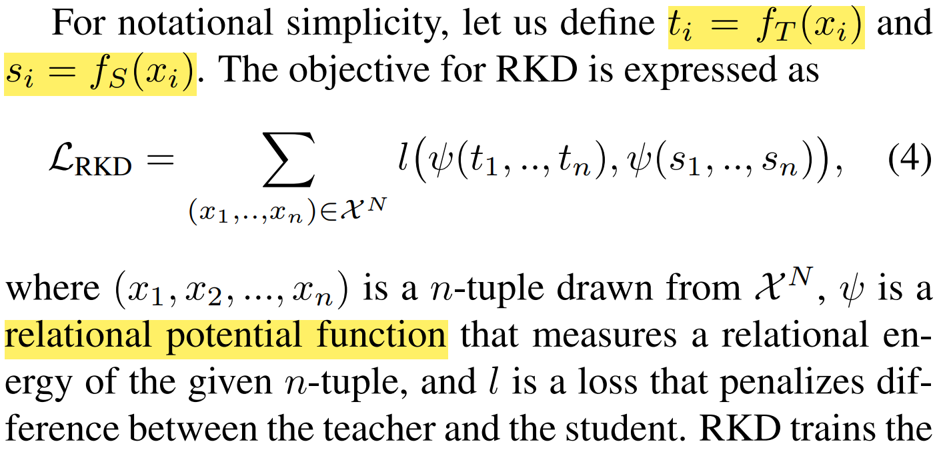
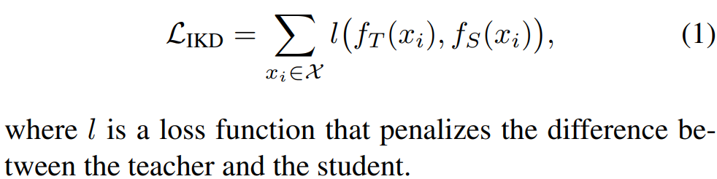

Slide 14
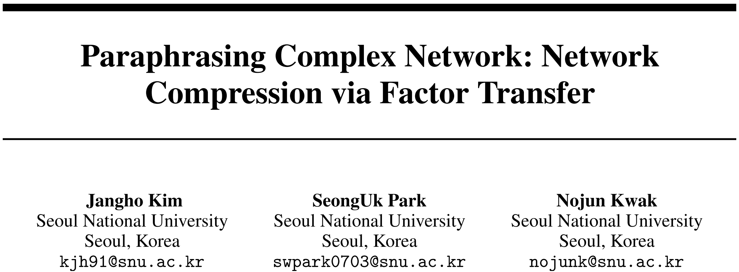
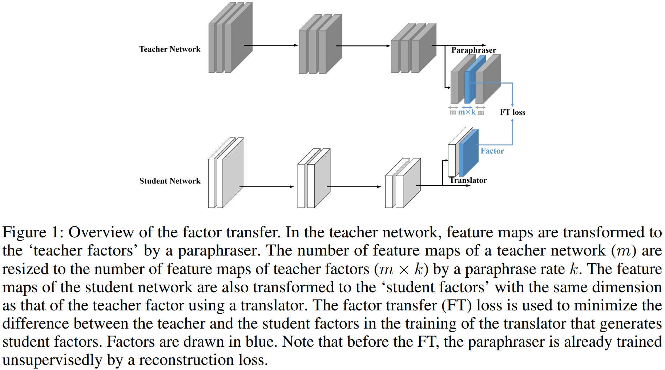
Factor Transfer
NeurIPS 2018

Slide 15
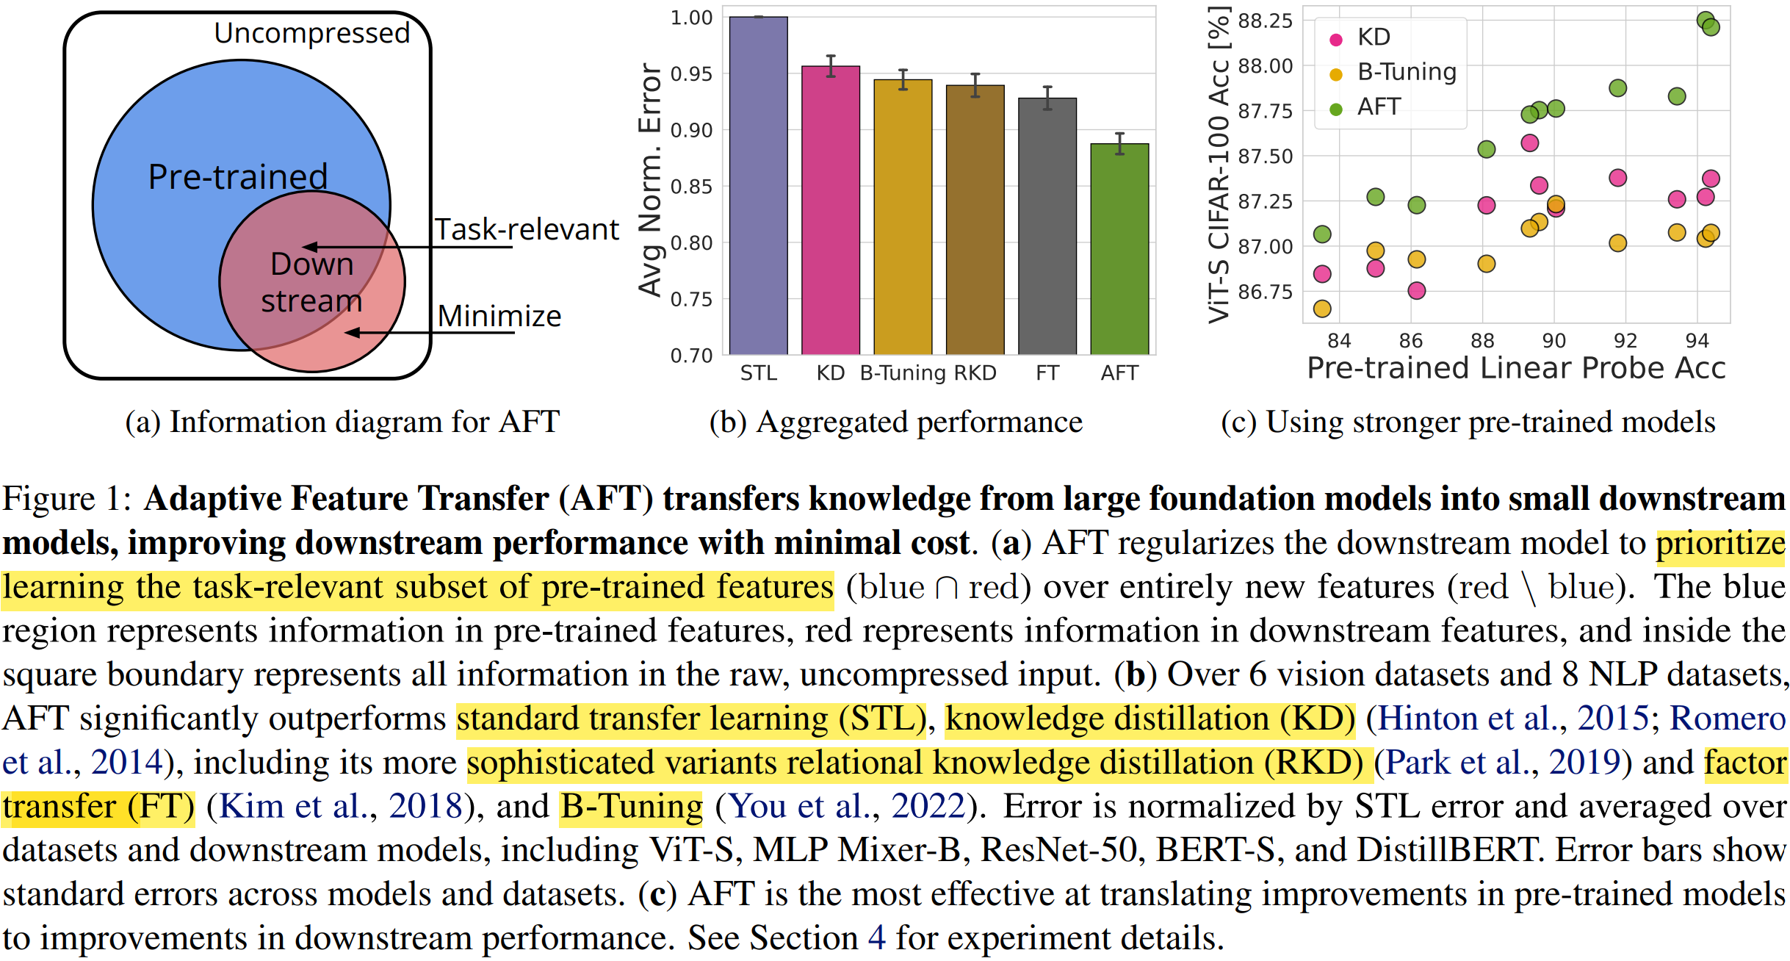

Slide 16
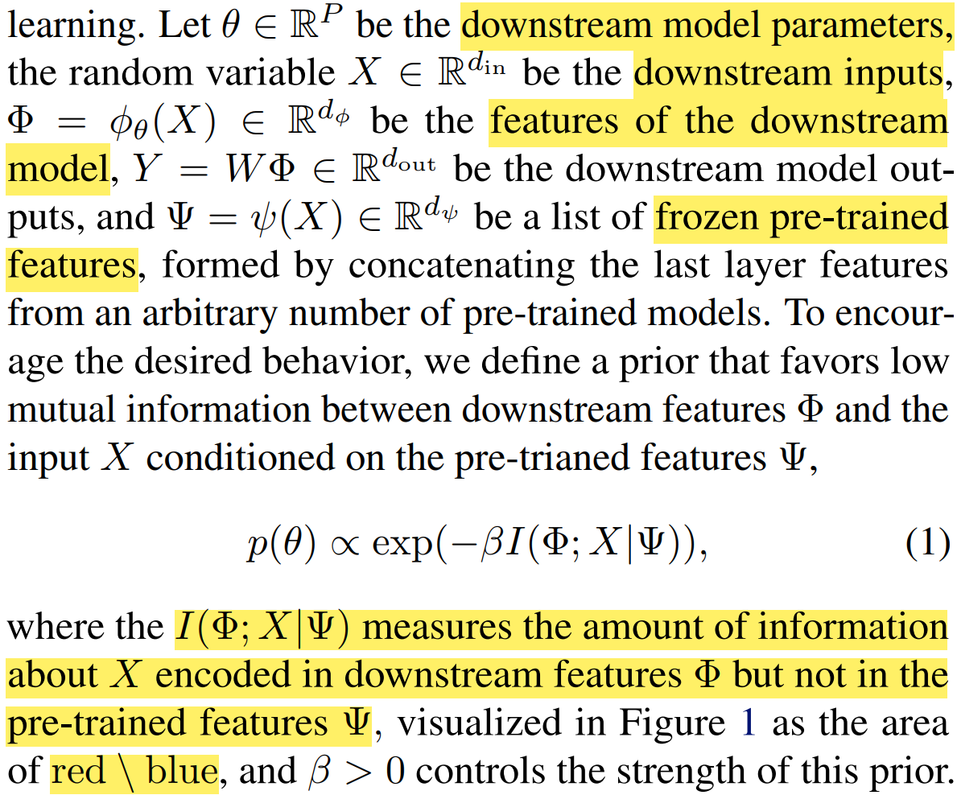
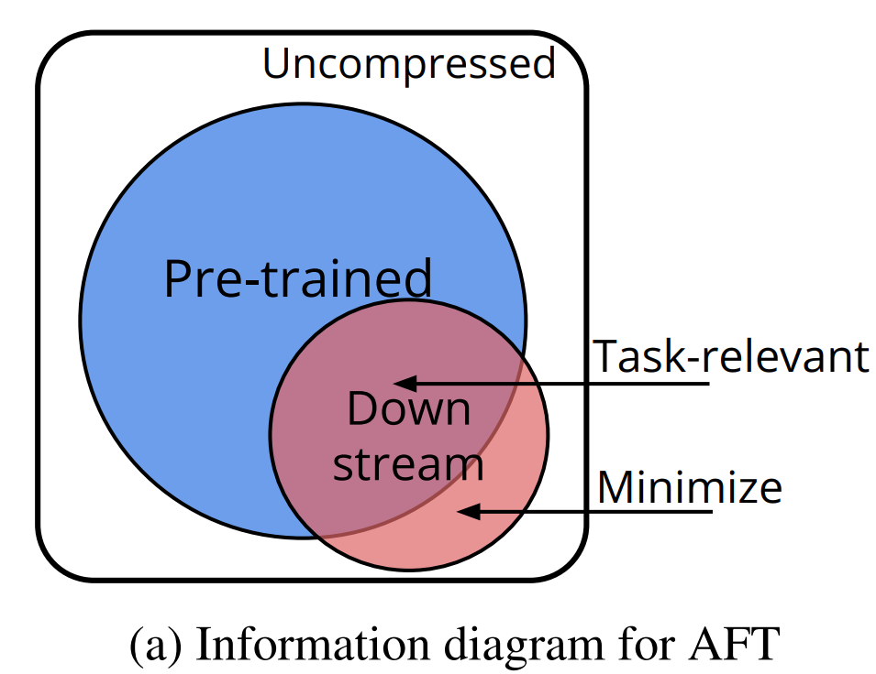
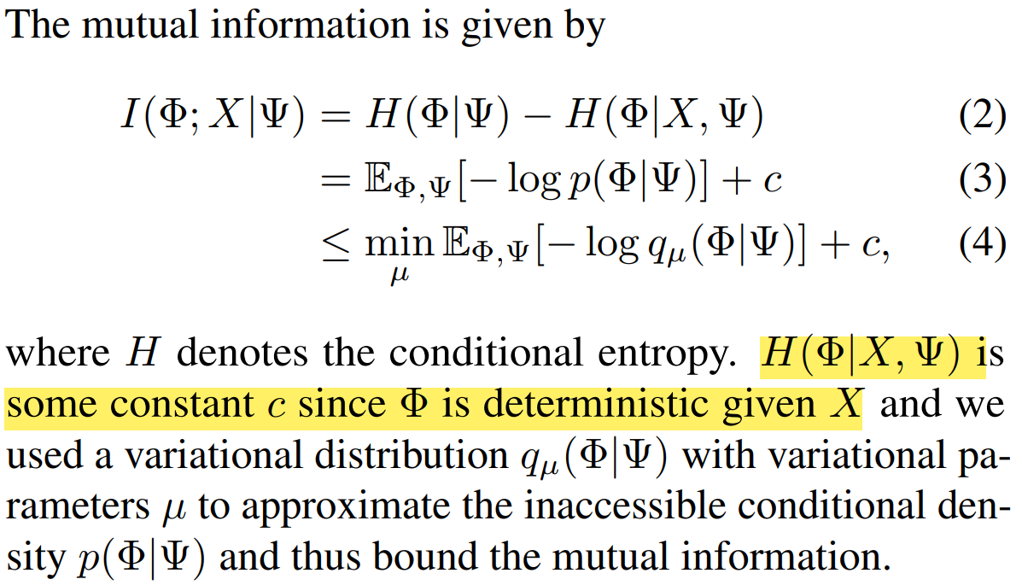

Slide 17
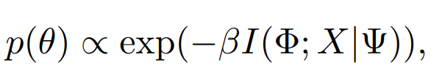
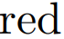

Slide 18
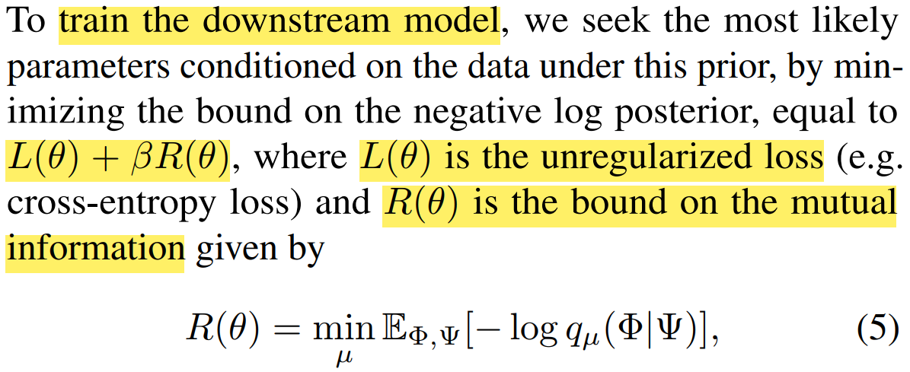
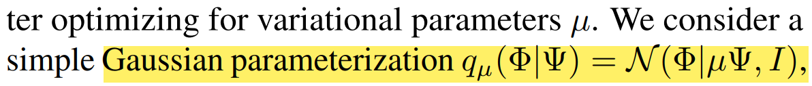
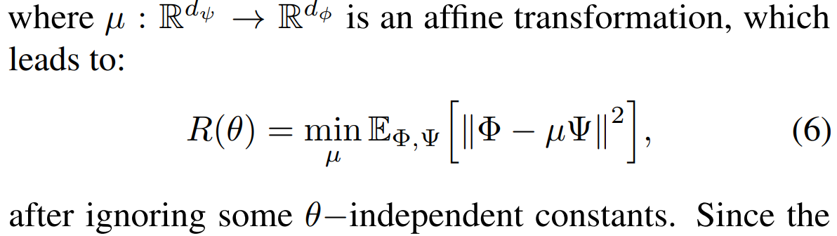

Slide 19
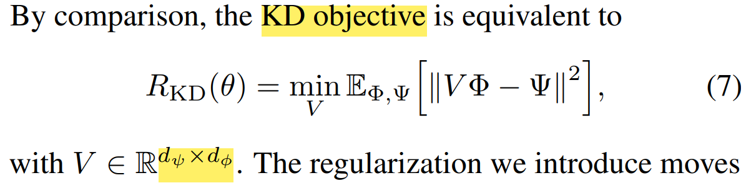

Slide 20
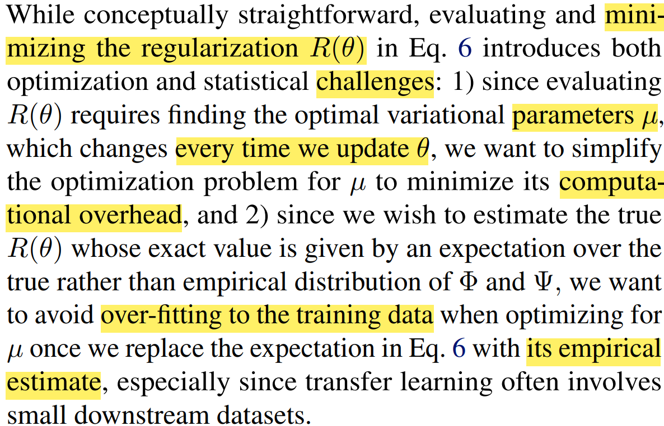

Slide 21
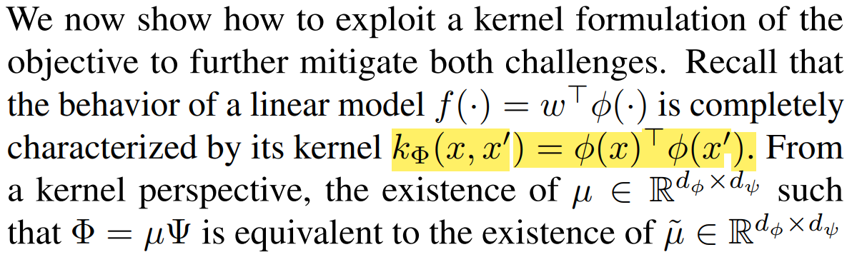
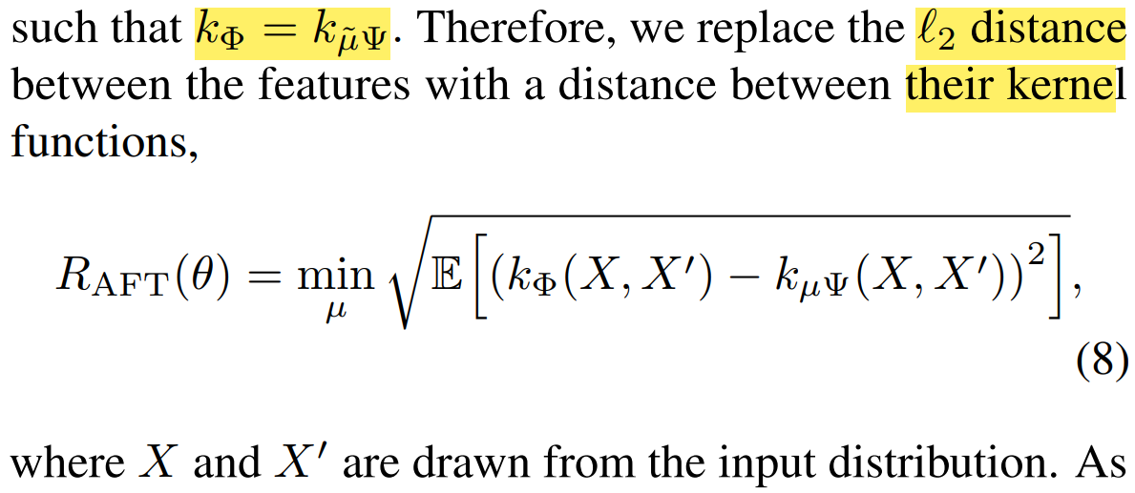

Slide 22
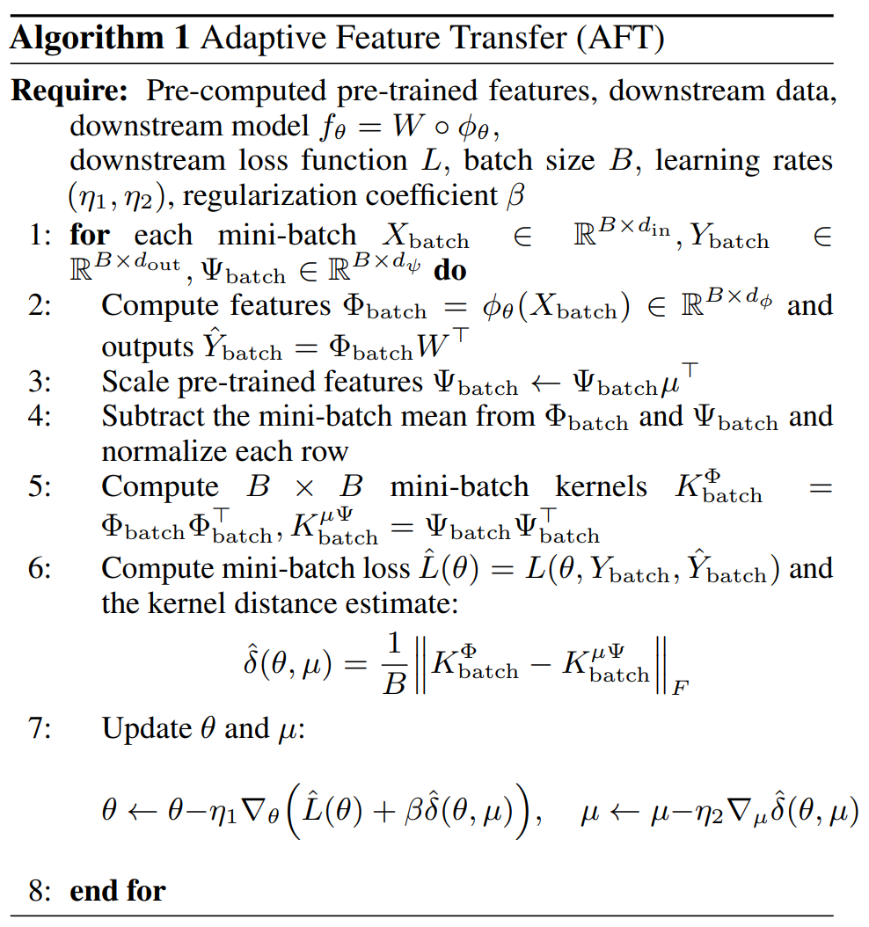

Slide 23
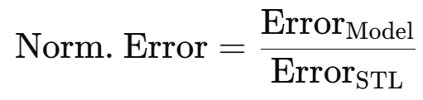
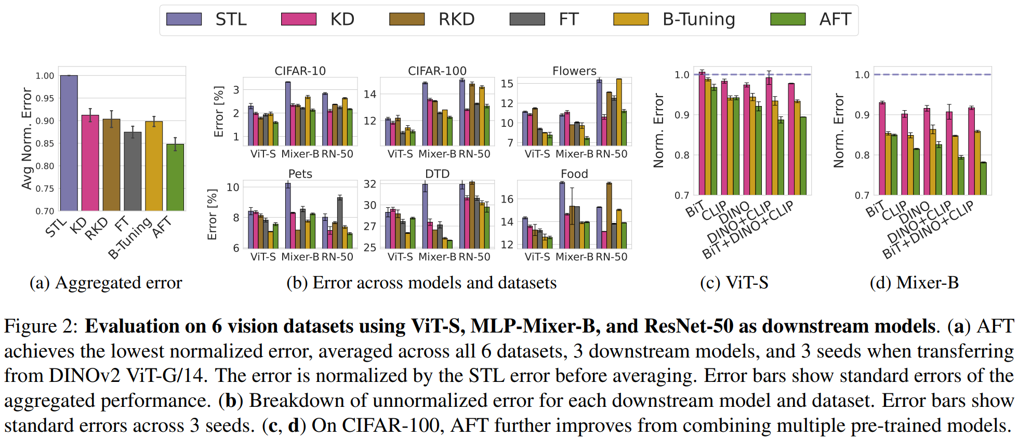

Slide 24
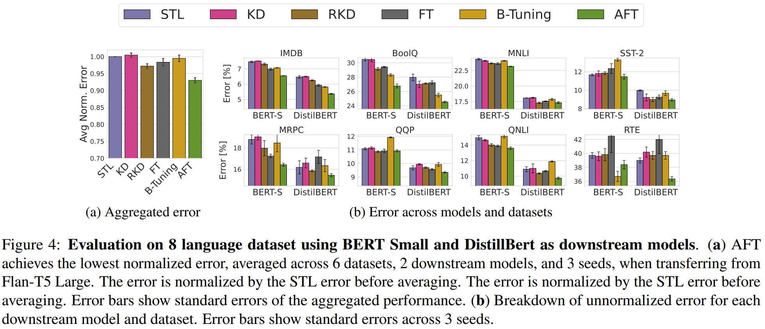

Slide 25
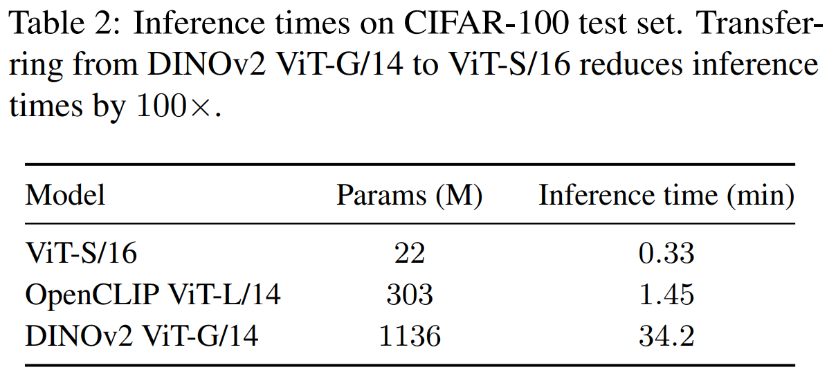

Slide 26
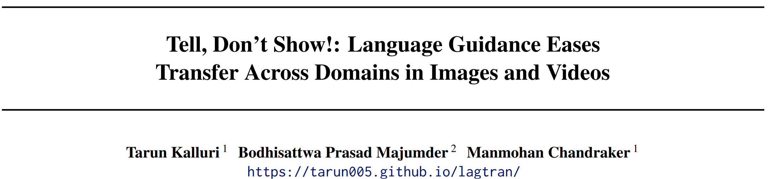
ICML 2024

Slide 27
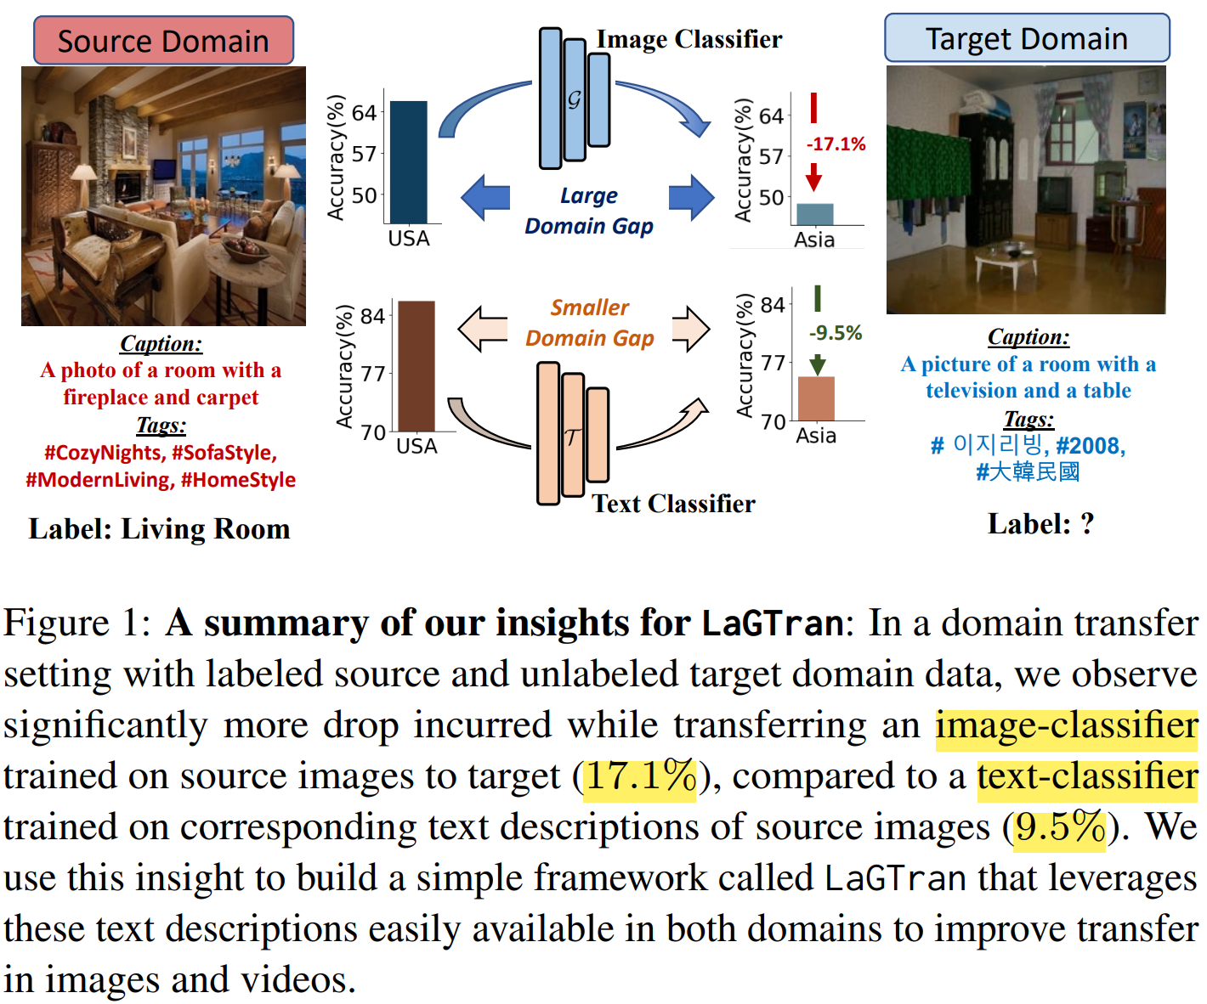
Motivation: utilizes text supervision to guide robust transfer of discriminative knowledge from labeled source domain to unlabeled target domain with domain shifts. (Image / Video Domain Shift)

Slide 28
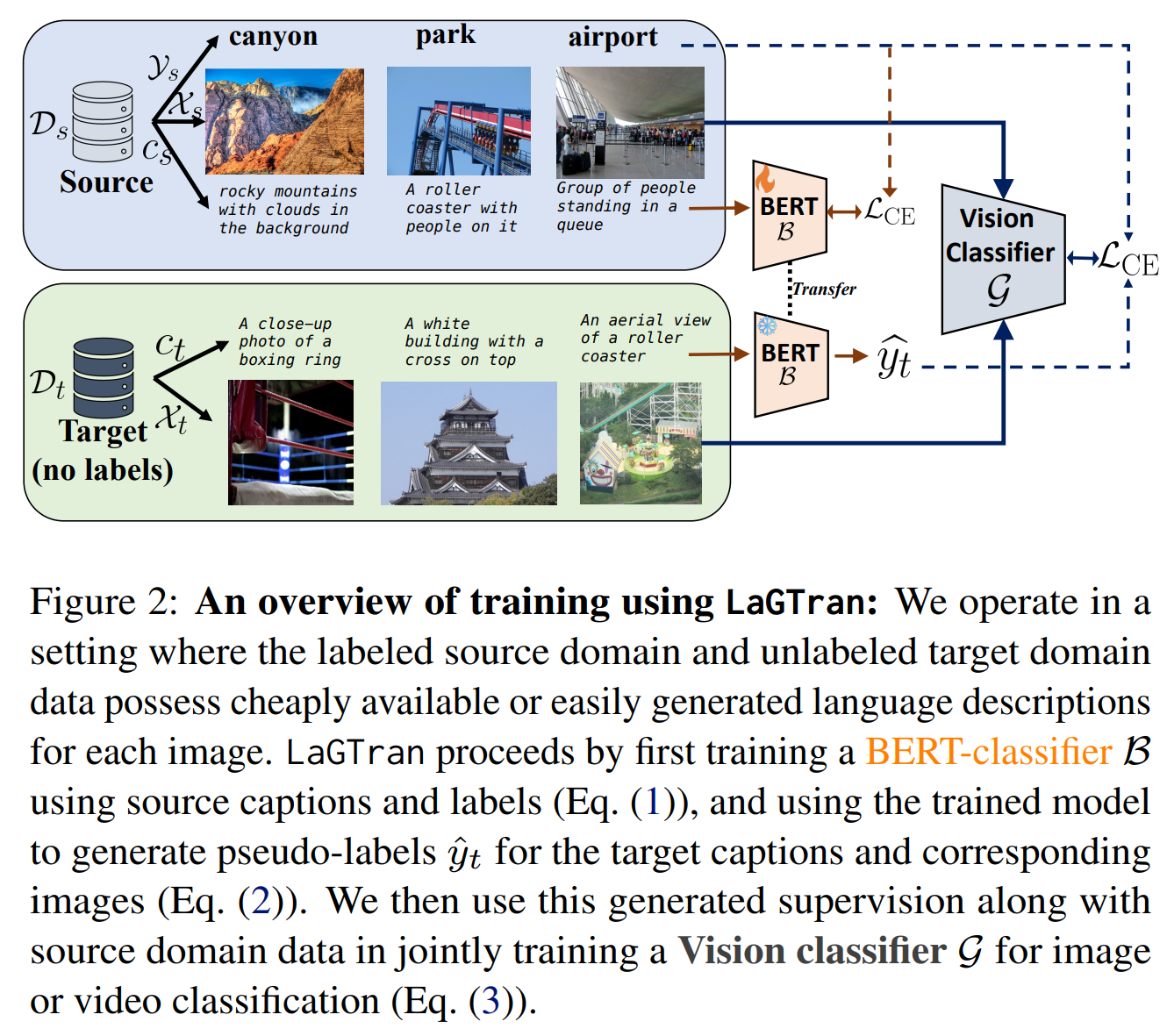
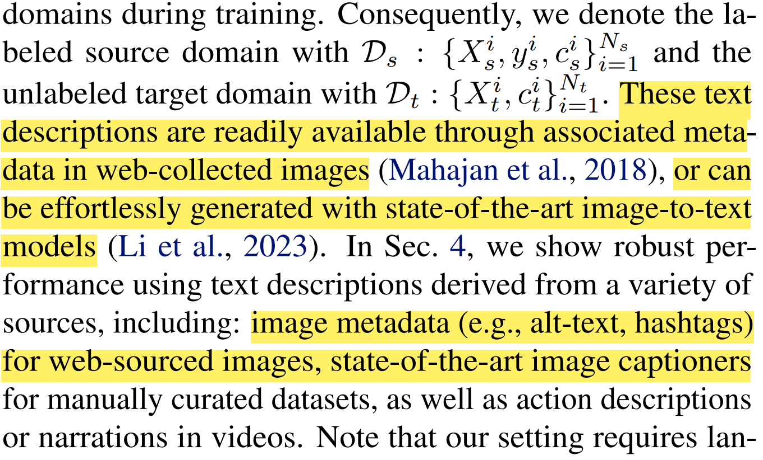
Language Guidance

Slide 29
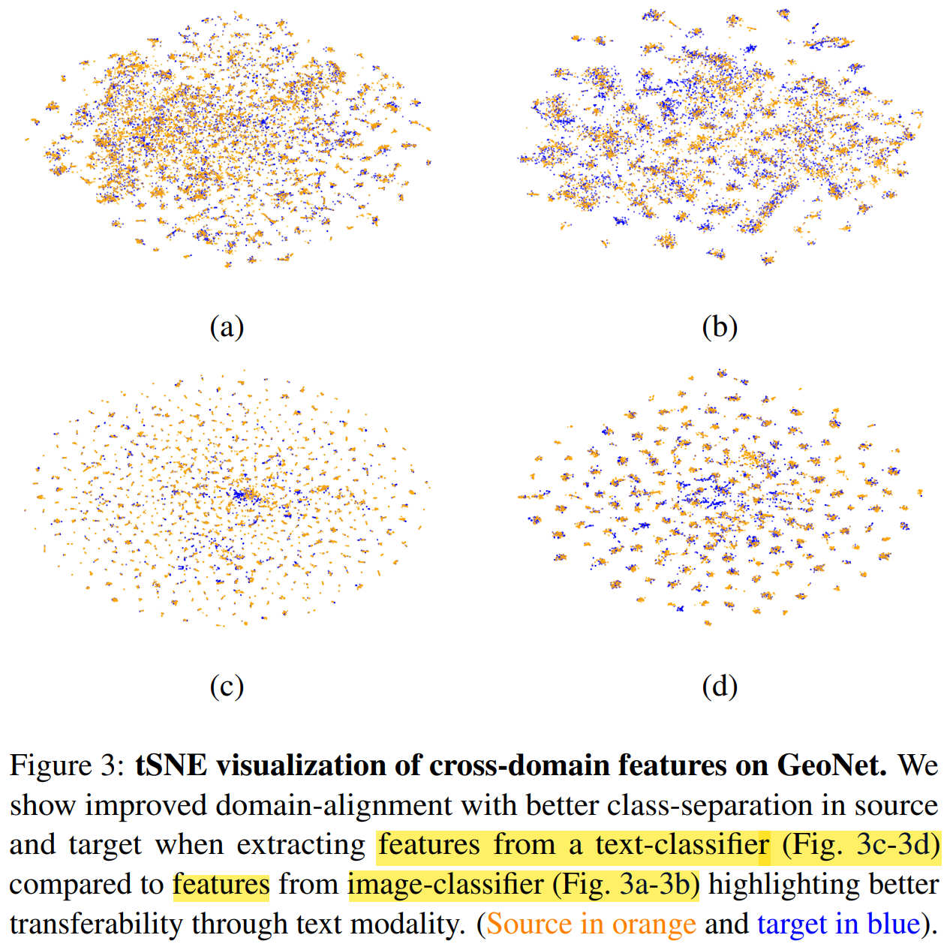
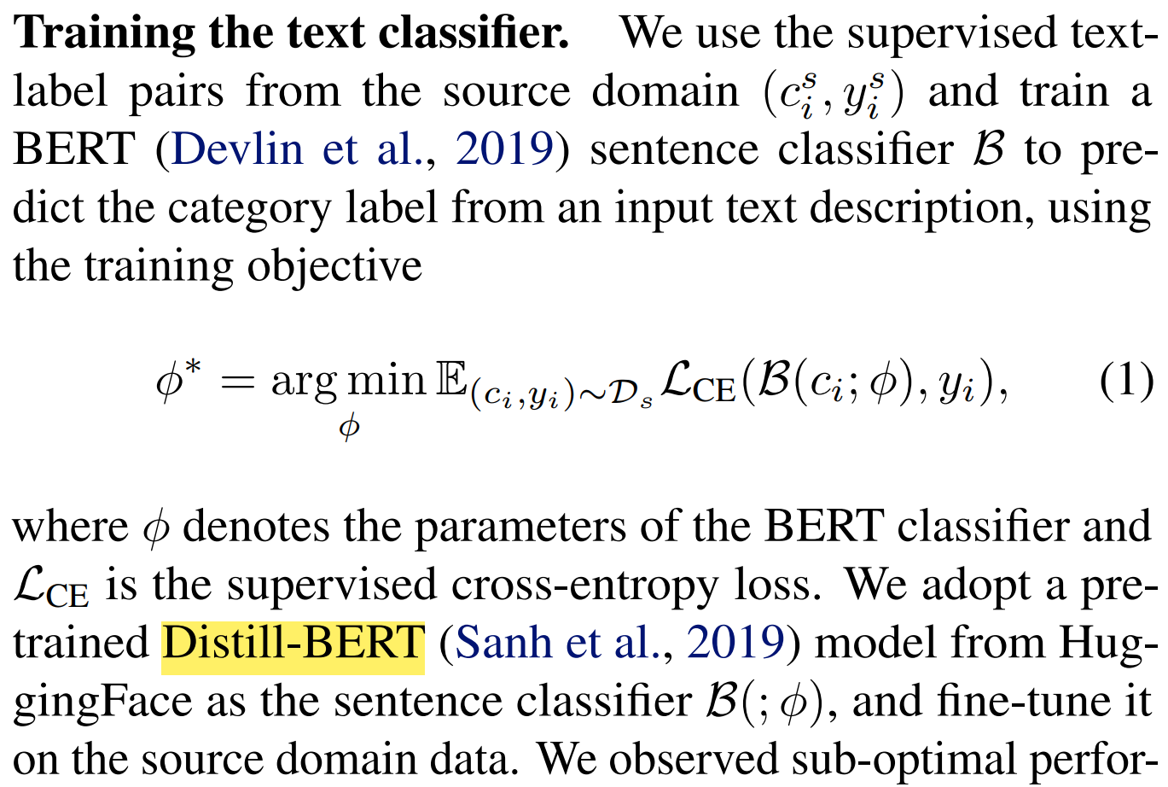

Slide 30
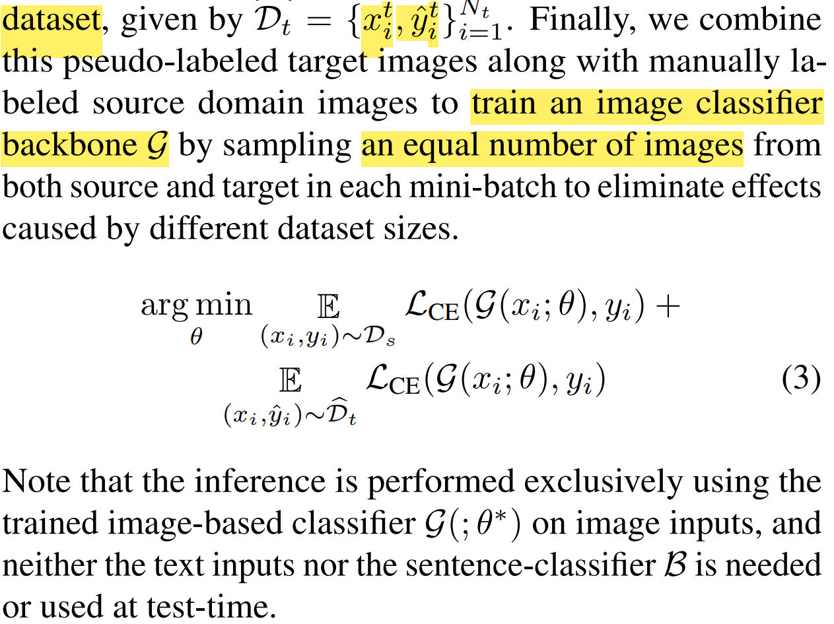
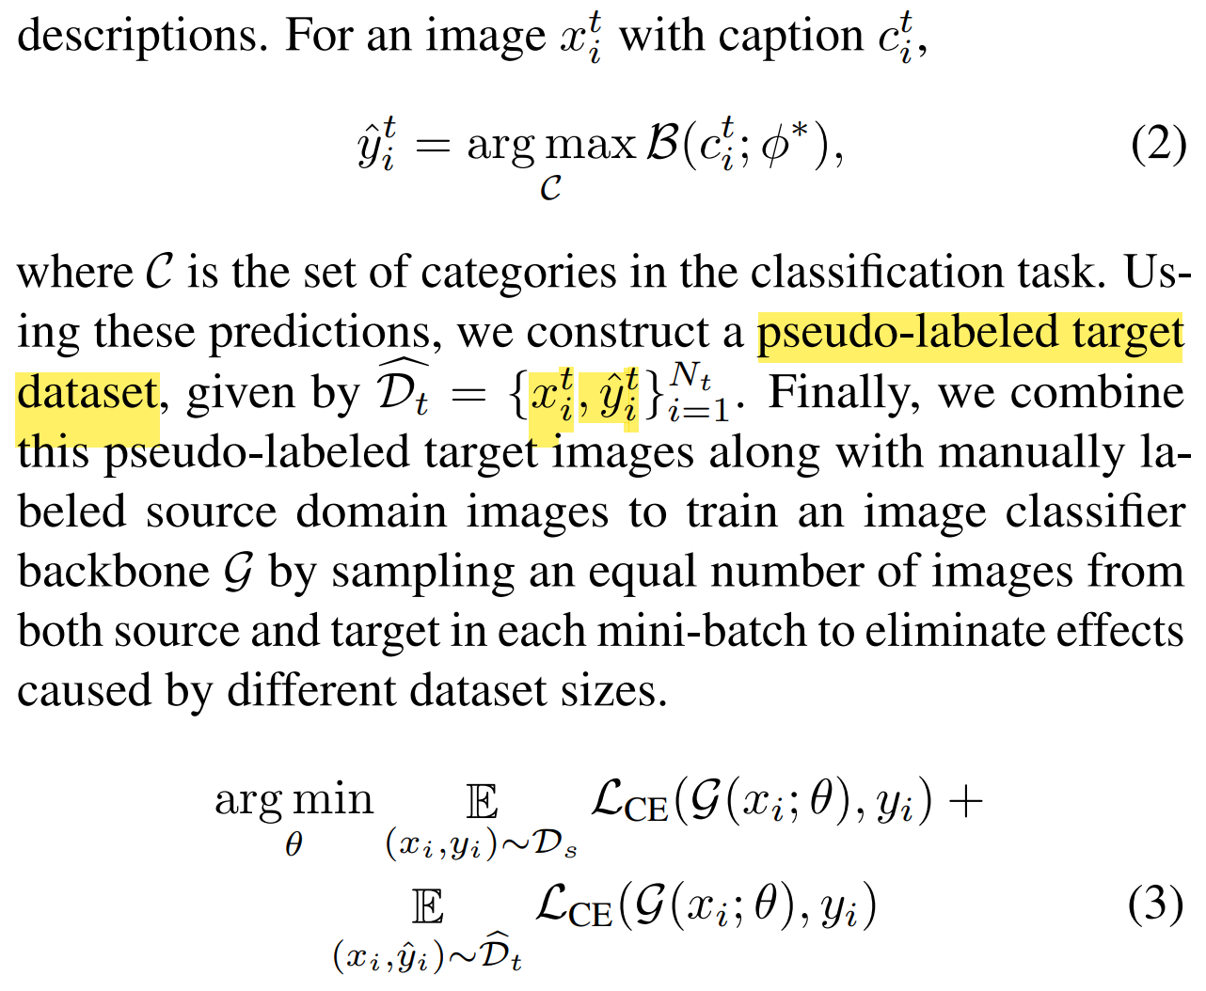

Slide 31
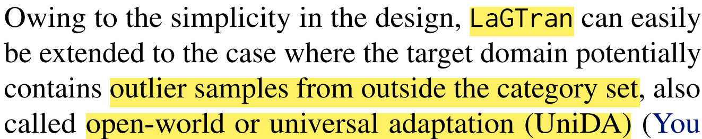
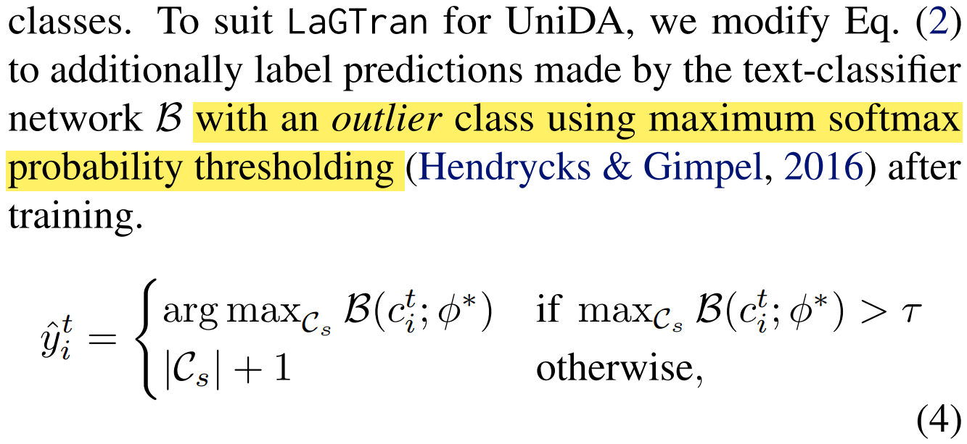


Slide 32


Slide 33


Slide 34


Slide 35



Slide 36


Slide 37



Slide 38
Appendix
[1] A survey on transfer learning. IEEE Transactions on knowledge and data engineering 2009.
[2] A comprehensive survey on transfer learning. Proceedings of the IEEE 2020.
[3] Zoo-Tuning: Adaptive Transfer from a Zoo of Models. ICML 2021.
[4] Ranking and tuning pre-trained models: A new paradigm for exploiting model hubs. Journal of
Machine Learning Research 2022.
[5] Relational knowledge distillation. CVPR 2019.
[6] Paraphrasing Complex Network: Network Compression via Factor Transfer. NeurIPS 2018.
[7] Knowledge Transfer from Vision Foundation Models for Efficient Training of Small Task-
specific Models. ICML 2024.

Slide 39
THANKS

